Slide 1
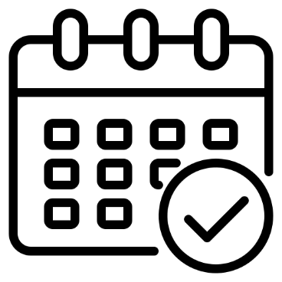


My Planner
User
Google Calendar

Slide 2
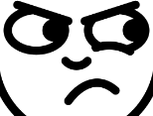
정보 저장 잘못했다가 해킹 당하면 큰일나는 거 아니냐;;
뭘 믿고 내 구글 계정을 알려줘?
My Planner
User
쟤는 뭔데 우리 정보를 저장하려고 하냐;;
Google Calendar

Slide 3
My Planner
User
Google Calendar

Slide 4
Client
My Planner
1) accessToken 발급
2) accessToken을 통해 필요한
정보 접근
Resource Owner
User
Resource Server
Google Calendar

Slide 5
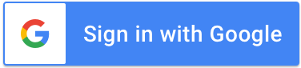
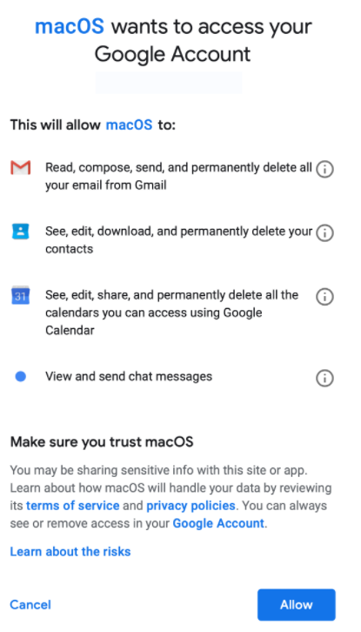
resource.server/
?client_id=1234 &scope=B,C
&redirect_uri= https://client/callback
Client ID: 1234
Client Secret: 0101
Client
Client
user.email.com
Client
Resource Owner
Client ID: 1234
Client Secret: 0101
Redirect URI: https://client/callback
User ID: aaa
- scope: B, C
Client
Resource Server

Slide 6
Client ID: 1234
Client Secret: 0101
Authorization code: 88
Client
Location: https://client/callback?code=88
Resource Owner
Client ID: 1234
Client Secret: 0101
Redirect URI: https://client/callback
User ID: aaa
scope: B, C
Authorization code: 88
Resource Server

